Slide 1
Chapter 10
Compiler I: Parsing

Slide 2
Usage Notice
You are welcome to use this presentation, or any part of it, in Nand to Tetris courses, or in other courses, as you see fit.
Usage is free for instruction in educational, non-profit settings.
For permission to use the materials in other settings, contact schocken@gmail.com
You can use the slides as-is, or modify them as needed.
We’ll appreciate it if you will credit Nand to Tetris somewhere, and put a reference to www.nand2tetris.org
To stay in touch with our course team about updates and new teaching materials, fill in this form.
Happy teaching!
Shimon Schocken / Noam Nisan

Slide 3
Compilation (one-tier)
high-level program
machine code
/** Tests the Point class. */
class Main {
function void main() {
var Point p1, p2, p3;
let p1 = Point.new(1,2);
let p2 = Point.new(3,4);
let p3 = p1.plus(p2);
do p3.print();
// Prints (4,6)
do Output.println();
do Output.printInt(p1.dist(p3));
// Prints 5
return;
}
}
...
1110111111001000
0000000000010001
1110101010001000
0000000000010000
1111110000010000
0000000000000000
1111010011010000
0000000000010010
1110001100000001
0000000000010000
1111110000010000
0000000000010001
0000000000010000
1110111111001000
0000000000010001
1110101010001000
0000000000010000
1111110000010000
0000000000000000
1111010011010000
0000000000010010
1110001100000001
0000000000010000
1111110000010000
0000000000010001
...
compiler
/** Represents a Point. */
class Point {
field int x, y;
static int pointCount;
/** Constructs a new point */
constructor Point new(int ax,
int ay) {
let x = ax;
let y = ay;
let pointCount =
pointCount + 1;
return this;
}
// ... more Point methods

Slide 4

Compilation (two-tier)
high-level program
VM code
machine code
/** Tests the Point class. */
class Main {
function void main() {
var Point p1, p2, p3;
let p1 = Point.new(1,2);
let p2 = Point.new(3,4);
let p3 = p1.plus(p2);
do p3.print();
// Prints (4,6)
do Output.println();
do Output.printInt(p1.dist(p3));
// Prints 5
return;
}
}
...
push local 0
push constant 0
eq
not
push argument 1
neg
push local 1
call div
pop argument 3
push local 1
neg
push local 0
push local 1
push local 2
add
push constant 2
push local 0
...
...
1110111111001000
0000000000010001
1110101010001000
0000000000010000
1111110000010000
0000000000000000
1111010011010000
0000000000010010
1110001100000001
0000000000010000
1111110000010000
0000000000010001
0000000000010000
1110111111001000
0000000000010001
1110101010001000
0000000000010000
1111110000010000
0000000000000000
1111010011010000
0000000000010010
1110001100000001
0000000000010000
1111110000010000
0000000000010001
...
VM translator
compiler
...
push constant 2
push local 0
pop argument 1
push local 0
push constant 0
not
push local 1
push local 0
push local 1
add
pop argument 3
push local 1
neg
push local 0
push local 1
push local 2
add
...
/** Represents a Point. */
class Point {
field int x, y;
static int pointCount;
/** Constructs a new point */
constructor Point new(int ax,
int ay) {
let x = ax;
let y = ay;
let pointCount =
pointCount + 1;
return this;
}
// ... more Point methods

Slide 5
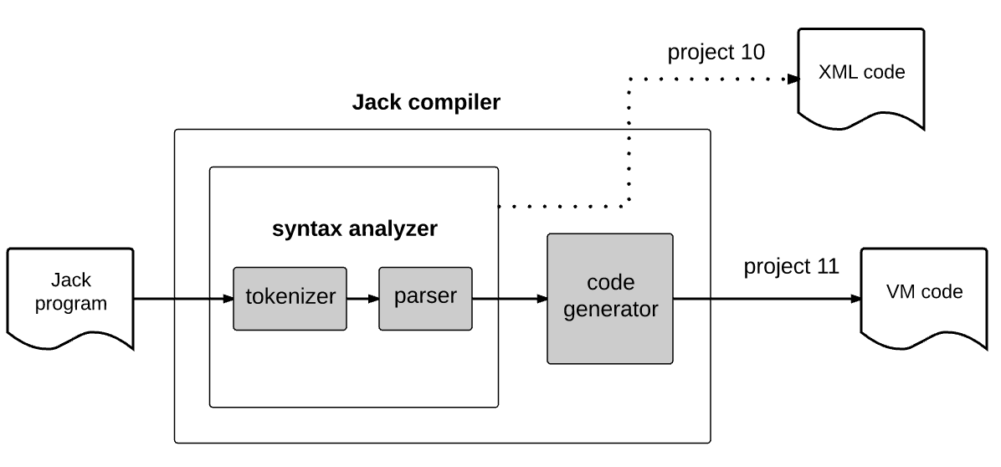
Compiler development roadmap
source language
target language

Slide 6
Compiler development roadmap
source language
target language
Understanding / parsing the semantics of the source language
Expressing the parsed semantics using the target language

Slide 7
Compiler development roadmap
source language
target language
project 10
project 11

Slide 8
Compiler development roadmap
source language
target language
project 10
In project 10 we “only” parse the source code, without generating VM code;
How can we tell that the syntax analyzer operates correctly?

Slide 9
Compiler development roadmap
source language
target language
project 10
In project 10 we “only” parse the source code, without generating VM code;
How can we tell that the syntax analyzer operates correctly?
We’ll generate XML code, and use it to unit-test syntax analyzer.

Slide 10
Compiler I / Syntax Analysis
Take home lessons:
Tokenizing
Grammars
Parsing
Parse trees
XML / mark-up
Handling structured data files
Common techniques in numerous applications and R&D projects

Slide 11
Lecture plan
Syntax analysis
Overview
Tokenizer
Grammar
Parse trees
Building a Jack analyzer
The analyzer’s design
The Jack grammar
The Jack analyzer
Overview
Proposed API
Project 10

Slide 12
Tokenizing

Slide 13
Tokenizing
Plan
Develop a tokenizer
Develop a program that tests the tokenizer by generating structured XML output that represents the source code’s tokens

Slide 14
Tokenizing
Prog.jack (input)
tokenized input
...
if (x < 0) {
// gets the sign
let sign = "negative";
}
...
...
if
(
x
<
0
{
let
sign
=
"negative"
;
}
...
The tokens are the “atoms” on which the compiler operates
tokenizing
compiler
stream of characters
stream of tokens
Lexicon = a group of valid tokens
Each programming language specifies its lexicon.

Slide 15
Jack lexicon
Prog.jack (input)
...
if (x < 0) {
// gets the sign
let sign = "negative";
}
...
keywords
symbols
integers
strings
identifiers

Slide 16
Jack lexicon
Prog.jack (input)
...
if (x < 0) {
// gets the sign
let sign = "negative";
}
...
keyword: 'class' | 'constructor' | 'function' | 'method' | 'field' | 'static' | 'var' | 'int' | 'char' | 'boolean' | 'void' | 'true' | 'false' | 'null' | 'this' | 'let' | 'do' | 'if' | 'else' | 'while' | 'return’
symbol: '{' | '}' | '(' | ')' | '[' | ']' | '. ' | ', ' | '; ' | '+' | '-' | '*' | '/' | '&' | '|' | '<' | '>' | '=' | '~'
integerConstant: a decimal number in the range 0 ... 32767
StringConstant: '"' a sequence of Unicode characters, not including double quote or newline '"'
identifier: a sequence of letters, digits, and underscore ( '_' ) not starting with a digit.

Slide 17
Jack tokenizer
Prog.jack (input)
output
...
if (x < 0) {
// gets the sign
let sign = "negative";
}
...
...
TokenizerTest
keyword: 'class' | 'constructor' | 'function' | 'method' | 'field' | 'static' | 'var' | 'int' | 'char' | 'boolean' | 'void' | 'true' | 'false' | 'null' | 'this' | 'let' | 'do' | 'if' | 'else' | 'while' | 'return’
symbol: '{' | '}' | '(' | ')' | '[' | ']' | '. ' | ', ' | '; ' | '+' | '-' | '*' | '/' | '&' | '|' | '<' | '>' | '=' | '~'
integerConstant: a decimal number in the range 0 ... 32767
StringConstant: '"' a sequence of Unicode characters, not including double quote or newline '"'
identifier: a sequence of letters, digits, and underscore ( '_' ) not starting with a digit.
Tokenizer services:
Checks if there are more tokens in the input
Gets the current token, and advances the input
Gets the token’s type
(complete API, later)

Slide 18
Jack tokenizer
Prog.jack (input)
output
...
if (x < 0) {
// gets the sign
let sign = "negative";
}
...
...
<keyword> if </keyword>
<symbol> ( </symbol>
<identifier> x </identifier>
<symbol> < </symbol>
<intConst> 0 </intConst>
<symbol> ) </symbol>
<symbol> { </symbol>
<keyword> let </keyword>
<identifier> sign </identifier>
<symbol> = </symbol>
<stringConst> negative </stringConst>
<symbol> ; </symbol>
<symbol> } </symbol>
...
TokenizerTest
keyword: 'class' | 'constructor' | 'function' | 'method' | 'field' | 'static' | 'var' | 'int' | 'char' | 'boolean' | 'void' | 'true' | 'false' | 'null' | 'this' | 'let' | 'do' | 'if' | 'else' | 'while' | 'return’
symbol: '{' | '}' | '(' | ')' | '[' | ']' | '. ' | ', ' | '; ' | '+' | '-' | '*' | '/' | '&' | '|' | '<' | '>' | '=' | '~'
integerConstant: a decimal number in the range 0 ... 32767
StringConstant: '"' a sequence of Unicode characters, not including double quote or newline '"'
identifier: a sequence of letters, digits, and underscore ( '_' ) not starting with a digit.
Tokenizer services:
Checks if there are more tokens in the input
Gets the current token, and advances the input
Gets the token’s type
(complete API, later)

Slide 19
Jack tokenizer
Prog.jack (input)
output
...
if (x < 0) {
// gets the sign
let sign = "negative";
}
...
...
<keyword> if </keyword>
<symbol> ( </symbol>
<identifier> x </identifier>
<symbol> < </symbol>
<intConst> 0 </intConst>
<symbol> ) </symbol>
<symbol> { </symbol>
<keyword> let </keyword>
<identifier> sign </identifier>
<symbol> = </symbol>
<stringConst> negative </stringConst>
<symbol> ; </symbol>
<symbol> } </symbol>
...
TokenizerTest
TokenizerTest (pseudo code)
Tokenizer services:
Checks if there are more tokens in the input
Gets the current token, and advances the input
Gets the token’s type
(complete API, later)
Notes:
Java: split (String) and regexp class

Slide 20
Jack tokenizer
Prog.jack (input)
output
...
if (x < 0) {
// gets the sign
let sign = "negative";
}
...
...
<keyword> if </keyword>
<symbol> ( </symbol>
<identifier> x </identifier>
<symbol> < </symbol>
<intConst> 0 </intConst>
<symbol> ) </symbol>
<symbol> { </symbol>
<keyword> let </keyword>
<identifier> sign </identifier>
<symbol> = </symbol>
<stringConst> negative </stringConst>
<symbol> ; </symbol>
<symbol> } </symbol>
...
TokenizerTest
TokenizerTest (pseudo code)
tknzr = new JackTokenizer("Prog.jack")
tknzr.advance(); // gets the first token
while tknzr.hasMoreTokens() {
tokenType = type of the current token
print "<" + tokenType + ">"
print the current token
print "</" + tokenType + ">"
print newLine
tknzr.advance();
}
Tokenizer services:
Checks if there are more tokens in the input
Gets the current token, and advances the input
Gets the token’s type
(complete API, later)
Notes:
Java: split (String) and regexp class

Slide 21
Compiler development roadmap

Slide 22
Compiler development roadmap

Slide 23
Lecture plan
Syntax analysis
Overview
Tokenizer
Grammar
Parse trees
Building a Jack analyzer
The analyzer’s design
The Jack grammar
The Jack analyzer
Overview
Proposed API
Project 10

Slide 24
Grammar
Lexicon: a set of valid words
Grammar: a set of rules, describing how words can be combined to form valid sentences
sentence: nounPhrase verbPhrase
nounPhrase: determiner? noun
verbPhrase: verb nounPhrase
noun: 'dog' | 'school' | 'dina' | 'he' | 'she' | 'homework' | ...
verb: 'went' | 'ate' | 'said' | ...
determiner: 'the' | 'to' | 'my' | ...
. . .
dina went to school
she said
the dog ate my homework
Each one of the three sentences is accepted (correctly parsed) by the grammar.

Slide 25
Grammar
Lexicon: a set of valid words
Grammar: a set of rules, describing how words can be combined to form valid sentences
sentence: nounPhrase verbPhrase
nounPhrase: determiner? noun
verbPhrase: verb nounPhrase
noun: 'dog' | 'school' | 'dina' | 'he' | 'she' | 'homework' | ...
verb: 'went' | 'ate' | 'said' | ...
determiner: 'the' | 'to' | 'my' | ...
. . .
Each rule has a left hand-side and a right hand-side
LHS: The rule name
Terminal rules: Their RHS specify no rule names
Nonterminal rules: All the other rules.

Slide 26
Grammar
Jack grammar (subset)
statement: letStatement | ifStatement | whileStatement
statements: statement*
letStatement: 'let' varName '=' expression ';’
ifStatement: 'if' '(' expression ')' '{' statements '}'
whileStatement: 'while' '(' expression ')' '{' statements '}'
expression: term (op term)?
term: varName | constant
varName: a string not beginning with a digit
constant: a decimal number
op: '+' | '-' | '=' | '>' | '<'
x*: x appears 0 or more times
x? : x appears 0 or 1 times

Slide 27
Grammar
Jack grammar (subset)
statement: letStatement | ifStatement | whileStatement
statements: statement*
letStatement: 'let' varName '=' expression ';’
ifStatement: 'if' '(' expression ')' '{' statements '}'
whileStatement: 'while' '(' expression ')' '{' statements '}'
expression: term (op term)?
term: varName | constant
varName: a string not beginning with a digit
constant: a decimal number
op: '+' | '-' | '=' | '>' | '<'
Nonterminals
Terminals

Slide 28
Grammar
Jack grammar (subset)
Input examples
statement: letStatement | ifStatement | whileStatement
statements: statement*
letStatement: 'let' varName '=' expression ';’
ifStatement: 'if' '(' expression ')' '{' statements '}'
whileStatement: 'while' '(' expression ')' '{' statements '}'
expression: term (op term)?
term: varName | constant
varName: a string not beginning with a digit
constant: a decimal number
op: '+' | '-' | '=' | '>' | '<'
let x = 100;

Slide 29
Grammar
Jack grammar (subset)
Input examples
statement: letStatement | ifStatement | whileStatement
statements: statement*
letStatement: 'let' varName '=' expression ';’
ifStatement: 'if' '(' expression ')' '{' statements '}'
whileStatement: 'while' '(' expression ')' '{' statements '}'
expression: term (op term)?
term: varName | constant
varName: a string not beginning with a digit
constant: a decimal number
op: '+' | '-' | '=' | '>' | '<'
let x = 100;
let x = x + 1;

Slide 30

Grammar
Jack grammar (subset)
Input examples
statement: letStatement | ifStatement | whileStatement
statements: statement*
letStatement: 'let' varName '=' expression ';’
ifStatement: 'if' '(' expression ')' '{' statements '}'
whileStatement: 'while' '(' expression ')' '{' statements '}'
expression: term (op term)?
term: varName | constant
varName: a string not beginning with a digit
constant: a decimal number
op: '+' | '-' | '=' | '>' | '<'
let x = 100;
let x = x + 1;
while (n < lim)
let n = n + 1;
}

Slide 31
Grammar
Jack grammar (subset)
Input examples
statement: letStatement | ifStatement | whileStatement
statements: statement*
letStatement: 'let' varName '=' expression ';’
ifStatement: 'if' '(' expression ')' '{' statements '}'
whileStatement: 'while' '(' expression ')' '{' statements '}'
expression: term (op term)?
term: varName | constant
varName: a string not beginning with a digit
constant: a decimal number
op: '+' | '-' | '=' | '>' | '<'
let x = 100;
let x = x + 1;
while (n < lim)
let n = n + 1;
}
if (x = 1) {
let x = 100;
let x = x + 1;
}

Slide 32
Grammar
Jack grammar (subset)
Input examples
statement: letStatement | ifStatement | whileStatement
statements: statement*
letStatement: 'let' varName '=' expression ';’
ifStatement: 'if' '(' expression ')' '{' statements '}'
whileStatement: 'while' '(' expression ')' '{' statements '}'
expression: term (op term)?
term: varName | constant
varName: a string not beginning with a digit
constant: a decimal number
op: '+' | '-' | '=' | '>' | '<'
while (lim < 100) {
if (x = 1) {
let z = 100;
while (z > 0) {
let z = z – 1;
}
}
let lim = lim + 10;
}
Parsing:
Determining if a given input is accepted by the grammar
In the process, uncovering the grammatical structure of the input.

Slide 33
Lecture plan
Syntax analysis
Overview
Tokenizer
Grammar
Parse trees
Building a Jack analyzer
The analyzer’s design
The Jack grammar
The Jack analyzer
Overview
Proposed API
Project 10

Slide 34
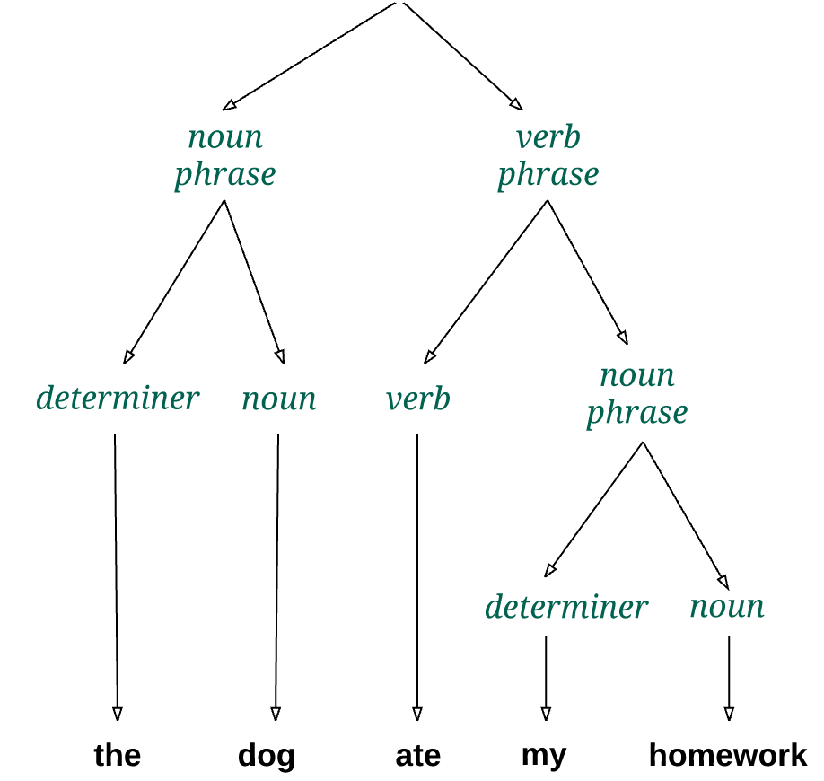
Parse tree
sentence: nounPhrase verbPhrase
nounPhrase: determiner? noun
verbPhrase: verb nounPhrase
noun: 'dog' | ’school' | 'dina' |
’he' | ’she' | 'homework’ | ...
verb: 'went' | 'ate' | ’said' | ...
determiner: 'the' | 'to' | 'my’ | ...
. . .
Parsing
Determining if the given input is accepted by the grammar
In the process, constructing the grammatical structure of the input
input

Slide 35
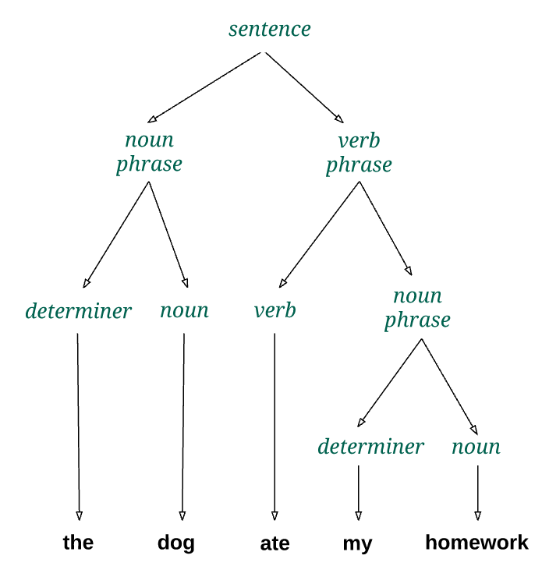
Parse tree
sentence: nounPhrase verbPhrase
nounPhrase: determiner? noun
verbPhrase: verb nounPhrase
noun: 'dog' | ’school' | 'dina' |
’he' | ’she' | 'homework’ | ...
verb: 'went' | 'ate' | ’said' | ...
determiner: 'the' | 'to' | 'my’ | ...
. . .
Parsing
Determining if the given input is accepted by the grammar
In the process, constructing the grammatical structure of the input
input

Slide 36
Parse tree
Jack grammar (subset)
statement: letStatement | ifStatement | whileStatement
statements: statement*
letStatement: 'let' varName '=' expression ';'
ifStatement: 'if' '(' expression ')' '{' statements '}'
whileStatement: 'while' '(' expression ')' '{' statements '}'
expression: term (op term)?
term: varName | constant
varName: a string not beginning with a digit
constant: a decimal number
op: '+' | '-' | '=' | '>' | '<'
prog.jack (input)
...
while (count < 100) {
let count = count + 1;
}
...
parser
Notes:
Note that the parse tree lists only non-terminals. varName, Constant, and op don’t appear in the tree.

Slide 37
Parse tree
Jack grammar (subset)
Same parse tree, expressed linearly using mark-up tags
statement: letStatement | ifStatement | whileStatement
statements: statement*
letStatement: 'let' varName '=' expression ';'
ifStatement: 'if' '(' expression ')' '{' statements '}'
whileStatement: 'while' '(' expression ')' '{' statements '}'
expression: term (op term)?
term: varName | constant
varName: a string not beginning with a digit
constant: a decimal number
op: '+' | '-' | '=' | '>' | '<'
...
<whileStatement>
<keyword> while </keyword>
<symbol> ( </symbol>
<expression>
<term> <varName> count </varName> </term>
<op> <symbol> < </symbol> </op>
<term> <constant> 100 </constant> </term>
</expression>
<symbol> ) </symbol>
<symbol> { </symbol>
<statements>
<statement> <letStatement>
<keyword> let </keyword>
<varName> count </varName>
<symbol> = </symbol>
<expression>
<term> <varName> count </varName> </term>
<op> <symbol> + </symbol> </op>
<term> <constant> 1 </constant> </term>
</expression>
<symbol> ; </symbol>
</letStatement> </statement>
</statements>
<symbol> } </symbol>
</whileStatement>
...
prog.jack (input)
...
while (count < 100) {
let count = count + 1;
}
...
The output that the JackAnalyzer is expected to generate (project 10)
parser

Slide 38
Lecture plan
Syntax analysis
Overview
Tokenizer
Grammar
Parse trees
Building a Jack analyzer
The analyzer’s design
The Jack grammar
The Jack analyzer
Overview
Proposed API
Project 10

Slide 39
Syntax analyzer
prog.jack (input)
Parse tree
...
while (count < 100) {
let count = count + 1;
}
...
...
<whileStatement>
<keyword> while </keyword>
<symbol> ( </symbol>
<expression>
<term> <varName> count </varName> </term>
<op> <symbol> < </symbol> </op>
<term> <constant> 100 </constant> </term>
</expression>
<symbol> ) </symbol>
<symbol> { </symbol>
<statements>
<statement> <letStatement>
<keyword> let </keyword>
<varName> count </varName>
<symbol> = </symbol>
<expression>
<term> <varName> count </varName> </term>
<op> <symbol> + </symbol> </op>
<term> <constant> 1 </constant> </term>
</expression>
<symbol> ; </symbol>
</letStatement> </statement>
</statements>
<symbol> } </symbol>
</whileStatement>
...
Syntax Analyzer

Slide 40
Syntax analyzer
The Syntax Analyzer
A computer program
Designed to accept / reject a given input (program)
In the process, builds the program’s parse tree (XML)
Designed according to the language grammar
prog.jack (input)
Parse tree
...
while (count < 100) {
let count = count + 1;
}
...
...
<whileStatement>
<keyword> while </keyword>
<symbol> ( </symbol>
<expression>
<term> <varName> count </varName> </term>
<op> <symbol> < </symbol> </op>
...
Syntax Analyzer

Slide 41
Syntax analyzer design
Jack grammar (subset)
statement: letStatement | ifStatement | whileStatement
statements: statement*
letStatement: 'let' varName '=' expression ';'
ifStatement: 'if' '(' expression ')' '{' statements '}'
whileStatement: 'while' '(' expression ')' '{' statements '}'
expression: term (op term)?
term: varName | constant
varName: a string not beginning with a digit
constant: a decimal number
op: '+' | '-' | '=' | '>' | '<'
The Syntax Analyzer
A computer program
Designed to accept / reject a given input (program)
In the process, builds the program’s parse tree (XML)
Designed according to the language grammar
prog.jack (input)
Parse tree
...
while (count < 100) {
let count = count + 1;
}
...
...
<whileStatement>
<keyword> while </keyword>
<symbol> ( </symbol>
<expression>
<term> <varName> count </varName> </term>
<op> <symbol> < </symbol> </op>
...
Syntax Analyzer

Slide 42
Syntax analyzer design
Jack grammar (subset)
Syntax analyzer implementation
statement: letStatement | ifStatement | whileStatement
statements: statement*
letStatement: 'let' varName '=' expression ';'
ifStatement: 'if' '(' expression ')' '{' statements '}'
whileStatement: 'while' '(' expression ')' '{' statements '}'
expression: term (op term)?
term: varName | constant
varName: a string not beginning with a digit
constant: a decimal number
op: '+' | '-' | '=' | '>' | '<'
class CompilationEngine {
...
compileLet() {
// code for compiling a let statement
}
...
compileWhile() {
// code for compiling a while statement
}
...
compileTerm() {
// code for compiling a term
}
...
}
We call the main module of the syntax analyzer
CompilationEngine
prog.jack (input)
Parse tree
...
while (count < 100) {
let count = count + 1;
}
...
...
<whileStatement>
<keyword> while </keyword>
<symbol> ( </symbol>
<expression>
<term> <varName> count </varName> </term>
<op> <symbol> < </symbol> </op>
...
Syntax Analyzer

Slide 43
Syntax analyzer design
Jack grammar (subset)
Syntax analyzer implementation
statement: letStatement | ifStatement | whileStatement
statements: statement*
letStatement: 'let' varName '=' expression ';'
ifStatement: 'if' '(' expression ')' '{' statements '}'
whileStatement: 'while' '(' expression ')' '{' statements '}'
expression: term (op term)?
term: varName | constant
varName: a string not beginning with a digit
constant: a decimal number
op: '+' | '-' | '=' | '>' | '<'
class CompilationEngine {
...
compileLet() {
// code for compiling a let statement
}
...
compileWhile() {
// code for compiling a while statement
}
...
compileTerm() {
// code for compiling a term
}
...
}
We call the main module of the syntax analyzer
CompilationEngine
Consists of a set of compilexxx methods,
One for each grammar rule xxx
How to implement these parsing methods?
prog.jack (input)
Parse tree
...
while (count < 100) {
let count = count + 1;
}
...
...
<whileStatement>
<keyword> while </keyword>
<symbol> ( </symbol>
<expression>
<term> <varName> count </varName> </term>
<op> <symbol> < </symbol> </op>
...
Syntax Analyzer

Slide 44
Syntax analyzer design
Jack grammar (subset)
Implementation of a typical parsing method:
statement: letStatement | ifStatement | whileStatement
statements: statement*
letStatement: 'let' varName '=' expression ';'
ifStatement: 'if' '(' expression ')' '{' statements '}'
whileStatement: 'while' '(' expression ')' '{' statements '}'
expression: term (op term)?
term: varName | constant
varName: a string not beginning with a digit
constant: a decimal number
op: '+' | '-' | '=' | '>' | '<'
// This method implements the rule whileStatement:
// 'while' '(' expression ')' '{' statements '}'
// It should be called if the current token is 'while'.
compileWhile()
(psuedo code)
prog.jack (input)
Parse tree
...
while (count < 100) {
let count = count + 1;
}
...
...
<whileStatement>
<keyword> while </keyword>
<symbol> ( </symbol>
<expression>
<term> <varName> count </varName> </term>
<op> <symbol> < </symbol> </op>
...
Syntax Analyzer

Slide 45
Syntax analyzer design
Jack grammar (subset)
Implementation of a typical parsing method:
statement: letStatement | ifStatement | whileStatement
statements: statement*
letStatement: 'let' varName '=' expression ';'
ifStatement: 'if' '(' expression ')' '{' statements '}'
whileStatement: 'while' '(' expression ')' '{' statements '}'
expression: term (op term)?
term: varName | constant
varName: a string not beginning with a digit
constant: a decimal number
op: '+' | '-' | '=' | '>' | '<'
// This method implements the rule whileStatement:
// 'while' '(' expression ')' '{' statements '}'
// It should be called if the current token is 'while'.
compileWhile()
print("<whileStatement>")
process("while")
process("(")
compileExpression()
process(")")
process("{")
compileStatements()
process("}")
print("</whileStatement>")
(psuedo code)
// A helper method that handles
// the current token, and advances
// to get the next token.
process(str)
if (currentToken == str)
printXMLToken(str)
else
print("syntax error")
currentToken =
tokenizer.advance()
prog.jack (input)
Parse tree
...
while (count < 100) {
let count = count + 1;
}
...
...
<whileStatement>
<keyword> while </keyword>
<symbol> ( </symbol>
<expression>
<term> <varName> count </varName> </term>
<op> <symbol> < </symbol> </op>
...
Syntax Analyzer

Slide 46
Syntax analyzer design
Jack grammar (subset)
Implementation of a typical parsing method:
statement: letStatement | ifStatement | whileStatement
statements: statement*
letStatement: 'let' varName '=' expression ';'
ifStatement: 'if' '(' expression ')' '{' statements '}'
whileStatement: 'while' '(' expression ')' '{' statements '}'
expression: term (op term)?
term: varName | constant
varName: a string not beginning with a digit
constant: a decimal number
op: '+' | '-' | '=' | '>' | '<'
// This method implements the rule whileStatement:
// 'while' '(' expression ')' '{' statements '}'
// It should be called if the current token is 'while'.
compileWhile()
print("<whileStatement>")
process("while")
process("(")
compileExpression()
process(")")
process("{")
compileStatements()
process("}")
print("</whileStatement>")
(psuedo code)
// A helper method that handles
// the current token, and advances
// to get the next token.
process(str)
if (currentToken == str)
printXMLToken(str)
else
print("syntax error")
currentToken =
tokenizer.advance()
Software engineering notes:
The syntax analyzer is version 0 of the compiler
The compiler is highly recursive: The compilexxx methods call each other, for their effect
Each compilexxx method is responsible for advancing the input and handling its own part of the input.

Slide 47
A bit of compilation theory
Jack grammar (subset)
statement: letStatement | ifStatement | whileStatement
statements: statement*
letStatement: 'let' varName '=' expression ';'
ifStatement: 'if' '(' expression ')' '{' statements '}'
whileStatement: 'while' '(' expression ')' '{' statements '}'
expression: term (op term)?
term: varName | constant
varName: a string not beginning with a digit
constant: a decimal number
op: '+' | '-' | '=' | '>' | '<'
LL Grammars
LL: Parsing the input from Left to right, performing Leftmost derivation of the input
LL(k): Looking ahead k tokens is sufficient for knowing which parsing rule to invoke next
LL(1) grammar: the first token informs which rule to invoke next
LL(1) grammars can be handled simply and elegantly by recursive descent parsing algorithms, without backtracking
prog.jack (input)
Parse tree
...
while (count < 100) {
let count = count + 1;
}
...
...
<whileStatement>
<keyword> while </keyword>
<symbol> ( </symbol>
<expression>
<term> <varName> count </varName> </term>
<op> <symbol> < </symbol> </op>
...
Syntax Analyzer

Slide 48
The Jack grammar is LL(1)
Jack grammar (subset)
statement: letStatement | ifStatement | whileStatement
statements: statement*
letStatement: 'let' varName '=' expression ';'
ifStatement: 'if' '(' expression ')' '{' statements '}'
whileStatement: 'while' '(' expression ')' '{' statements '}'
expression: term (op term)?
term: varName | constant
varName: a string not beginning with a digit
constant: a decimal number
op: '+' | '-' | '=' | '>' | '<'
LL Grammars
LL: Parsing the input from Left to right, performing Leftmost derivation of the input
LL(k): Looking ahead k tokens is sufficient for knowing which parsing rule to invoke next
LL(1) grammar: the first token informs which rule to invoke next
LL(1) grammars can be handled simply and elegantly by recursive descent parsing algorithms, without backtracking
The complete Jack grammar is LL(1), barring one exception that can be handled easily
(to be discussed soon)

Slide 49
Lecture plan
Syntax analysis
Overview
Tokenizer
Grammar
Parse trees
Building a Jack analyzer
The analyzer’s design
The Jack grammar
The Jack analyzer
Overview
Proposed API
Project 10

Slide 50
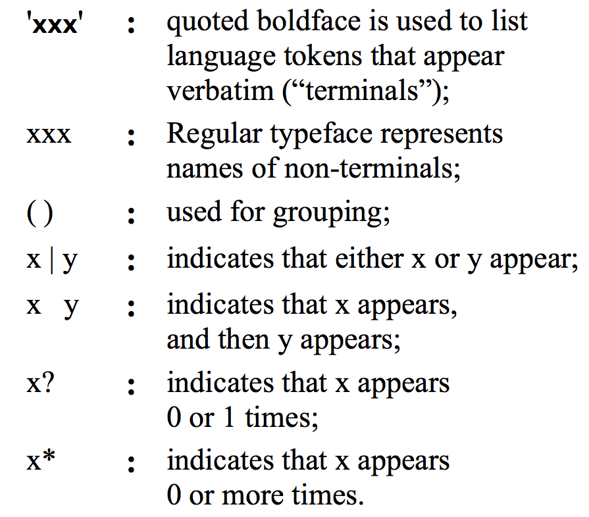
Grammar notation
Jack grammar (subset)
statement: letStatement | ifStatement | whileStatement
statements: statement*
letStatement: 'let' varName '=' expression ';'
ifStatement: 'if' '(' expression ')' '{' statements '}'
whileStatement: 'while' '(' expression ')' '{' statements '}'
expression: term (op term)?
term: varName | constant
varName: a string not beginning with a digit
constant: a decimal number
op: '+' | '-' | '=' | '>' | '<'

Slide 51
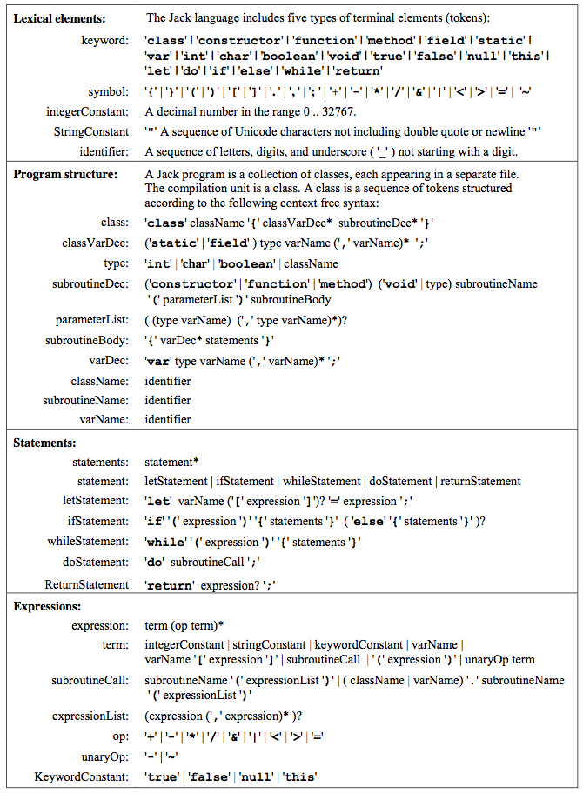
Jack grammar
Lexical elements (tokens)
Program structure
Statements
Expressions

Slide 52
Jack grammar: lexical elements
The Jack language features five categories of terminal elements (tokens):

Slide 53
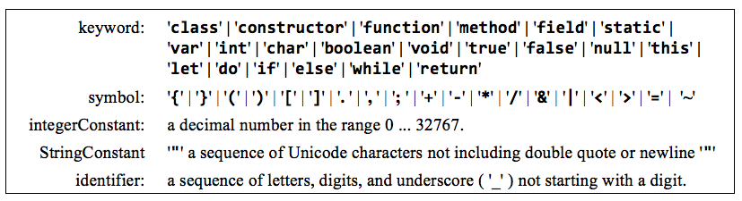
Jack grammar: lexical elements
The Jack language features five categories of terminal elements (tokens):

Slide 54
Jack grammar
Lexical elements
Program structure
Statements
Expressions

Slide 55
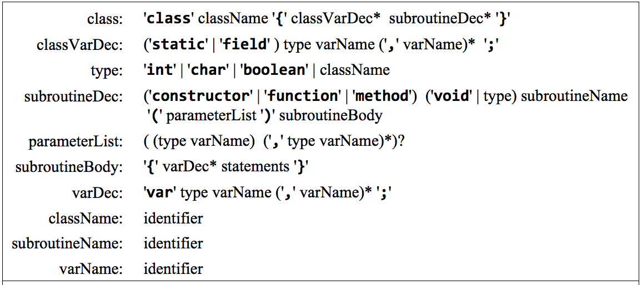
Jack grammar: program structure
A Jack program is a collection of classes, each appearing in a separate file, and each compiled separately. Each class is structured as follows:

Slide 56
Jack grammar
Lexical elements
Program structure
Statements
Expressions

Slide 57
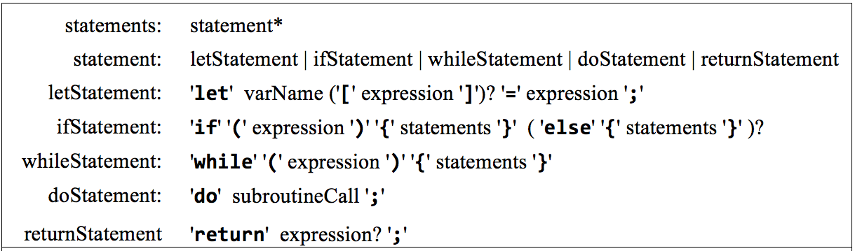
Jack grammar: statements
A Jack program includes statements, as follows:

Slide 58
Jack grammar
Lexical elements
Program structure
Statements
Expressions

Slide 59
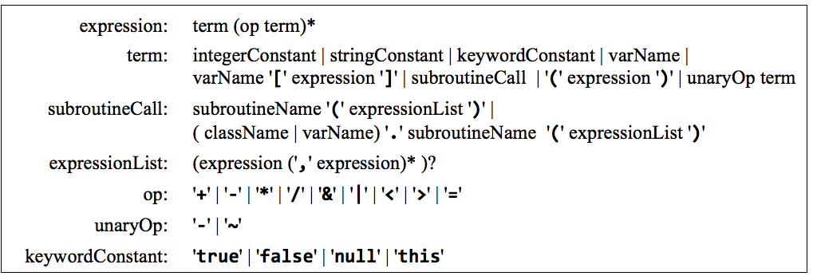
Jack grammar: expressions
A Jack program can includes expressions, as follows:

Slide 60
Lecture plan
Syntax analysis
Overview
Tokenizer
Grammar
Parse trees
Building a Jack analyzer
The analyzer’s design
The Jack grammar
The Jack analyzer
Overview
Proposed API
Project 10

Slide 61
Jack analyzer: usage
prompt> JackAnalyzer input
input:
fileName.jack: name of a single source file, or
folderName: name of a folder containing one or more .jack source files
output:
If the input is a single file: fileName.xml
If the input is a folder: one .xml file for every .jack file, stored in the given folder

Slide 62
Jack analyzer: usage
Example: Point.jack
Point.vm
/** Represents a Point. */
class Point {
...
/** Returns the x value */
method int getx() {
return x;
}
...
}
<class>
<keyword> class </keyword>
<identifier> Point </identifier>
<symbol> { </symbol>
...
<subroutineDec>
<keyword> method </keyword>
<keyword> int </keyword>
<identifier> getx </identifier>
<symbol> ( </symbol>
<parameterList>
</parameterList>
<symbol> ) </symbol>
<subroutineBody>
<symbol> { </symbol>
<statements>
<returnStatement>
<keyword> return </keyword>
<expression>
<term>
<identifier> x </identifier>
</term>
</expression>
<symbol> ; </symbol>
</returnStatement>
</statements>
<symbol> } </symbol>
</subroutineBody>
</subroutineDec>
...
<symbol> } </symbol>
<class>
JackAnalyzer
The analyzer handles:
tokens (terminals)
rules (nonterminals)

Slide 63
Jack analyzer: handling tokens (terminals)
If the analyzer encounters a terminal element xxx
It generates the output:
where terminalType is:
keyword, symbol, integerConstant, stringConstant, identifier
<terminalType> xxx </terminalType>
Output examples:
<keyword> method </keyword>
<symbol> { </symbol>
<integerConstant> 42 </integerConstant>
<stringConstant> xkcd </stringConstant>
<symbol> { </symbol>
String constants are outputted without their enclosing double quotes

Slide 64
Jack analyzer: handling rules (nonterminals)
If the analyzer encounters one of the nonterminal elements:
class declaration, class variable declaration, subroutine declaration, parameter list, subroutine body, variable declaration, statements, let statement, if statement, while statement, do statement, return statement, an expression, a term, or an expression list
It generates the output:
where nonTerminal is:
class, classVarDec, subroutineDec, parameterList, subroutineBody, varDec; statements, LetStatement, ifStatement, whileStatement, doStatement, returnStatement; expression, term, expressionList
<nonTerminal>
Recursive output for the nonterminal body
</nonTerminal>
Example:
The output of compileExpression, which was called by compileReturn
// Jack grammar
...
returnStatement: ’return' expression? ';’
…
expression: term (op term)?
…
Generated output:
<returnStatement>
<keyword> return </keyword>
<expression>
<term>
<identifier> x </identifier>
</term>
</expression>
<symbol> ; </symbol>
</returnStatement>
input example:
return x;
Jack analyzer

Slide 65
Jack analyzer: handling rules (nonterminals)
If the analyzer encounters one of the (simple) nonterminal elements:
type, class name, subroutine name, var name, statement, or subroutine call,
It handles the body of the nonterminal directly, without calling other methods
(because it simplifies the implementation).
Example:
// Jack grammar
...
letStatement: 'let' varName '=' expression ';’
varName: identifier
identifier: a sequence of letters, digits, …, not starting with a digit
...
Generated output:
<letStatement>
<keyword> let </keyword>
<identifier> x </identifier>
<symbol> = </symbol>
<expression>
...
input example:
let x = 17;
Jack analyzer
There is no varNamexxx method.
The parsing of the varName is handled directly, by compileLet

Slide 66
Lecture plan
Syntax analysis
Overview
Tokenizer
Grammar
Parse trees
Building a Jack analyzer
The analyzer’s design
The Jack grammar
The Jack analyzer
Overview
Proposed API
Project 10

Slide 67
Jack Analyzer: Proposed implementation
Modules
JackTokenizer : Handles the input
CompilationEngine: Handles the parsing
JackAnalyzer: Drives the translation process.

Slide 68
JackTokenizer
Function
Handles the compiler’s input.
Provides services for:
Ignoring white space
Getting the current token and advancing the input just beyond it
Getting the type of the current token
JackTokenizer API (first approximation)
class JackTokenizer {
Constructor(inputFile)
hasMoreTokens()
advance()
tokenType()
...
}

Slide 69
JackTokenizer
Function
Handles the compiler’s input.
Provides services for:
Ignoring white space
Getting the current token and advancing the input just beyond it
Getting the type of the current token
JackTokenizer API (first approximation)
class JackTokenizer {
Constructor(inputFile)
hasMoreTokens()
advance()
tokenType()
...
}
The implementation of the tokenType method is informed by the Jack lexicon:

Slide 70
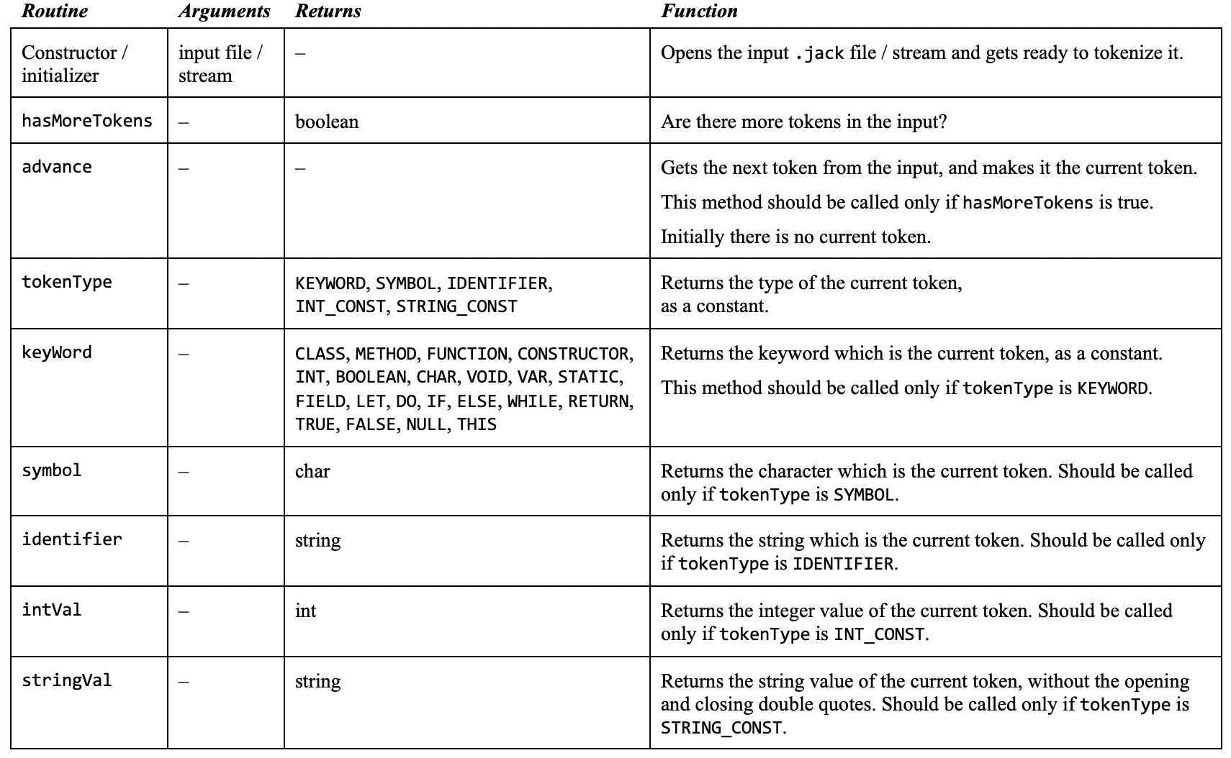
JackTokenizer API
JackTokeinizer: Ignores all comments and white space, gets the next token, and advances the input just beyond it

Slide 71
JackTokenizer API
JackTokeinizer: Ignores all comments and white space, gets the next token, and advances the input just beyond it

Slide 72
Jack Analyzer: Proposed implementation
Modules
JackTokenizer : Handles the input
CompilationEngine: Handles the parsing
JackAnalyzer: Drives the translation process.

Slide 73
CompilationEngine
Grammar
CompilationEngine API (first approximation)
...
statement: ifStatement | whileStatement | letStatement | ...
statements: statement*
ifStatement: 'if' '(' expression ')’ '{' statements '}’
whileStatement: 'while' '(' expression ')’ '{' statements '}’
…
class CompilationEngine {
// Constructor (code omitted)
// Compiles statements
compileStatements()
// Compiles an if statement
compileIf()
// Compiles a while statement
compileWhile()
...
}
Gets its input from a JackTokenizer, and emits its output to an output file
The output is generated by a series of compilexxx routines, structured according to the grammar rules that define xxx
Each compilexxx routine is responsible for handling all the tokens that make up xxx, advancing the tokenizer exactly beyond these tokens, and outputing the parsing of xxx.

Slide 74
CompilationEngine API
CompilationEngine: Generates the compiler’s output
(API continues next slide):
Routine
Arguments
Returns
Function

Slide 75
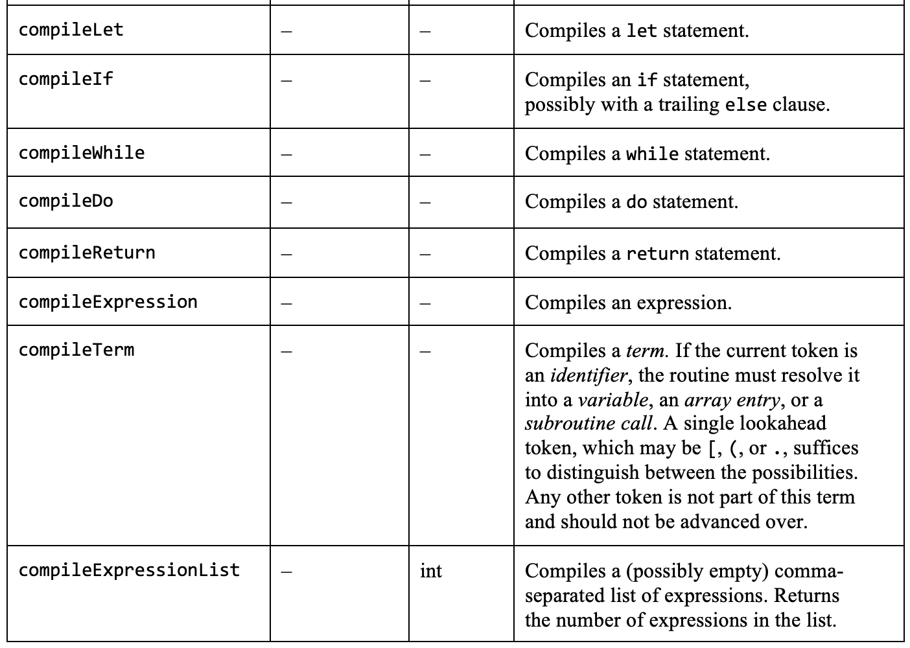
CompilationEngine API
CompilationEngine: Generates the compiler’s output
(API continues next slide):
Routine
Arguments
Returns
Function

Slide 76
CompilationEngine API
CompilationEngine: Generates the compiler’s output
(API continues next slide):
Routine
Arguments
Returns
Function
Reminder:
The following Jack grammar rules are handled directly, and have no corresponding compilexxx methods:
type, className, subroutineName, variableName, statement, subroutineCall

Slide 77
Jack Analyzer: Proposed implementation
Modules
JackTokenizer : Handles the input
CompilationEngine: Handles the parsing
JackAnalyzer: Drives the translation process.

Slide 78
JackAnalyzer
The top-most / main module
Input: a single fileName.jack, or a folder containing 0 or more such files
For each file:
Creates a JackTokenizer from fileName.jack
Creates an output file named fileName.xml
Creates a CompilationEngine, and calls the compileClass method.

Slide 79
Jack Analyzer: Proposed implementation
Modules
JackTokenizer : Handles the input
CompilationEngine: Handles the parsing
JackAnalyzer: Drives the translation process.

Slide 80
Lecture plan
Syntax analysis
Overview
Tokenizer
Grammar
Parse trees
Building a Jack analyzer
The analyzer’s design
The Jack grammar
The Jack analyzer
Overview
Proposed API
Project 10

Slide 81
Project 10: Building a Jack analyzer
Contract:
Implement a syntax analyzer for the Jack language
Test it by parsing the supplied test .jack class files
For each test .jack file, your analyzer should generate an .xml output file, identical to the supplied compare file.
Tools and resources:
Test programs and compare files: nand2tetris/projects/10
TextComparer: nand2tetris/tools
XML file viewer: Use a web browser or a text editor
Programming language: Java, Python, ...
Reference: chapter 10 in The Elements of Computing Systems.

Slide 82
Implementation plan
Build a Jack Tokenizer
Build a compilation engine (a Jack analyzer that uses the Tokenizer’s services):
Basic version
Complete version.

Slide 83
Jack tokenizer
TestClass.jack
TestClassT.xml
...
if (x < 0) {
let sign = "negative";
}
...
<tokens>
<keyword> if </keyword>
<symbol> ( </symbol>
<identifier> x </identifier>
<symbol> &lt; </symbol>
<integerConstant> 0 </integerConstant>
<symbol> ) </symbol>
<symbol> { </symbol>
<keyword> let </keyword>
<identifier> sign </identifier>
<symbol> = </symbol>
<stringConstant> negative </stringConstant>
<symbol> ; </symbol>
<symbol> } </symbol>
</tokens>
TokenizerTest
string constants are outputted without the double-quotes
<, >, ", and & are outputted as &lt;, &gt;, &quot;, and &amp;
Implement the JackTokenizer API, and write a TokenizerTest program
Note: The TokenizerTest will not be used in the JackAnalyzer; Its only purpose is unit-testing the tokenizer.
Notes:
Java: split (String) and regexp class

Slide 84
Jack tokenizer
TestClass.jack
TestClassT.xml
...
if (x < 0) {
let sign = "negative";
}
...
<tokens>
<keyword> if </keyword>
<symbol> ( </symbol>
<identifier> x </identifier>
<symbol> &lt; </symbol>
<integerConstant> 0 </integerConstant>
<symbol> ) </symbol>
<symbol> { </symbol>
<keyword> let </keyword>
<identifier> sign </identifier>
<symbol> = </symbol>
<stringConstant> negative </stringConstant>
<symbol> ; </symbol>
<symbol> } </symbol>
</tokens>
TokenizerTest
Implementation tips:
Use your implementation language services for
File processing
String processing
Tokenizing (if you want)

Slide 85
Jack analyzer
TestClass.jack
TestClass.xml
...
let x = x * (x + 1);
...
...
<letStatement>
<keyword> let </keyword>
<identifier> x </identifier>
<symbol> = </symbol>
<expression>
<term>
<identifier> x </identifier>
</term>
<symbol> * </symbol>
<term>
<symbol> ( </symbol>
<expression>
<term>
<identifier> x </identifier>
</term>
<symbol> * </symbol>
<term>
<integerConstant> 1 </integerConstant>
</term>
</expression>
<symbol> ) </symbol>
</term>
</expression>
<symbol> ; </symbol>
</letStatement>
...
JackAnalyzer
Implementation:
Build a basic CompilationEngine that handles everything except expressions
Add the handling of expressions later
(we supply test files for unit-testing both stages).

Slide 86
Sample test file
projects/10/Square/Square.jack
class Square {
field int x, y; // location on the screen
field int size; // The size of the square
...
// Increments the square size by 2.
method void incSize() {
if (((y + size) < 254) & ((x + size) < 510)) {
do erase();
let size = size + 2;
do draw();
}
return;
}
...
// Moves the square up by 2 pixels.
method void moveUp() {
if (y > 1) {
do Screen.setColor(false);
do Screen.drawRectangle(x, (y + size) - 1, x + size, y + size);
let y = y - 2;
...

Slide 87
Sample test file (expressions highlighted)
projects/10/Square/Square.jack
class Square {
field int x, y; // location on the screen
field int size; // The size of the square
...
// Increments the square size by 2.
method void incSize() {
if (((y + size) < 254) & ((x + size) < 510)) {
do erase();
let size = size + 2;
do draw();
}
return;
}
...
// Moves the square up by 2 pixels.
method void moveUp() {
if (y > 1) {
do Screen.setColor(false);
do Screen.drawRectangle(x, (y + size) - 1, x + size, y + size);
let y = y - 2;
...

Slide 88
Sample test file (expressionless version)
projects/10/Square/Square.jack
projects/10/ExpressionLessSquare/Square.jack
class Square {
field int x, y; // location on the screen
field int size; // The size of the square
...
// Increments the square size by 2.
method void incSize() {
if (((y + size) < 254) & ((x + size) < 510)) {
do erase();
let size = size + 2;
do draw();
}
return;
}
...
// Moves the square up by 2 pixels.
method void moveUp() {
if (y > 1) {
do Screen.setColor(false);
do Screen.drawRectangle(x, (y + size) - 1, x + size, y + size);
let y = y - 2;
...
class Square {
field int x, y; // location on the screen
field int size; // The size of the square
...
// Increments the square size by 2.
method void incSize() {
if (x) {
do erase();
let size = size;
do draw();
}
return;
}
...
// Moves the square up by 2 pixels.
method void moveUp() {
if (y) {
do Screen.setColor(false);
do Screen.drawRectangle(x, y, x, y);
let y = y;
...
The expressionless code is meaningless, but is grammatically valid
Purpose: Unit-test the analyzer's ability to parse everything except for expressions.

Slide 89
Implementation plan
Build a Jack Tokenizer
Build a compilation engine (a Jack analyzer that makes use of the Tokenizer’s services):
Basic version (handles everything except expressions)
Complete version (handles everything, including expressions)

Slide 90
Handling expressions
Implementation note 1
If the current token is a varName (some identifier), it can be the first token in any one of these possibilities:
foo
foo[expression]
foo.bar(expressionList)
Foo.bar(expressionList)
foo(expressionList)
To resolve which possibility we’re in, the syntax analyzer must look ahead:
Save the current token, and
Advance to get the next one
This is the only case in which the Jack grammar becomes LL(2) rather than LL(1).

Slide 91
Handling expressions
Implementation note 2
There is no compileSubroutineCall method
Rather, the subroutine call logic is handled in compileTerm
(Makes the implementation simpler).

Slide 92
Compiler development roadmap
project 10
Project 10: Generates XML code, for unit-testing the syntax analyzer

Slide 93
Compiler development roadmap
project 10
project 11
Project 10: Generates XML code, for unit-testing the syntax analyzer
Project 11: We’ll replace the logic that generates passive XML code with logic that generates executable VM code.

Slide 94
Perspective: Error Handling
The Jack analyzer does not handle errors
Error handling
Detection
Handling
Reporting.

Slide 95
Perspective: Tools
Parsing tools
Since the design of a syntax analyzer is informed by the language grammar, it can written automatically
LEX / YACC
Many similar tools

Slide 96
Perspective: Applications
Parsing applications
Compilation
Computational linguistics
Natural language processing
Communications
Bioinformatics
Fintech
Blockchain
...

Slide 97
Chapter 10
Compiler I: Parsing

